Slide 1
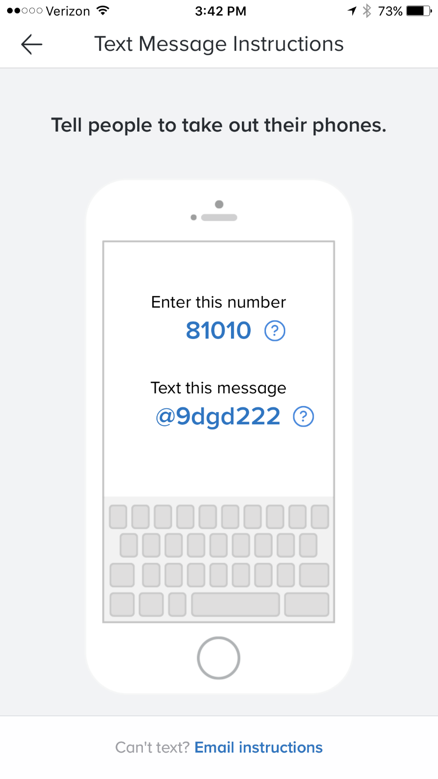
Patriot Pride Honors Chorus
Sign up for Remind.com
Heritagechorus.weebly.com
Sign up for Remind.com

Slide 2
Patriot Pride Objectives
Sing year-long
Serious about singing
School wide opportunity
Rewarding experience
Heritage Community Pride

Slide 3
CONGRATULATIONS!
Welcome to this amazing choir!
As the year goes on, you will realize what a great opportunity this is for you and your student!
We are DEDICATED!
Mrs. Shuler, Director
Mrs. Przybyl, Accompanist
Mrs. Arteta, Uniform Chair

Slide 4
Introduction of new members
CONGRATULATIONS and
WELCOME!!

Slide 5
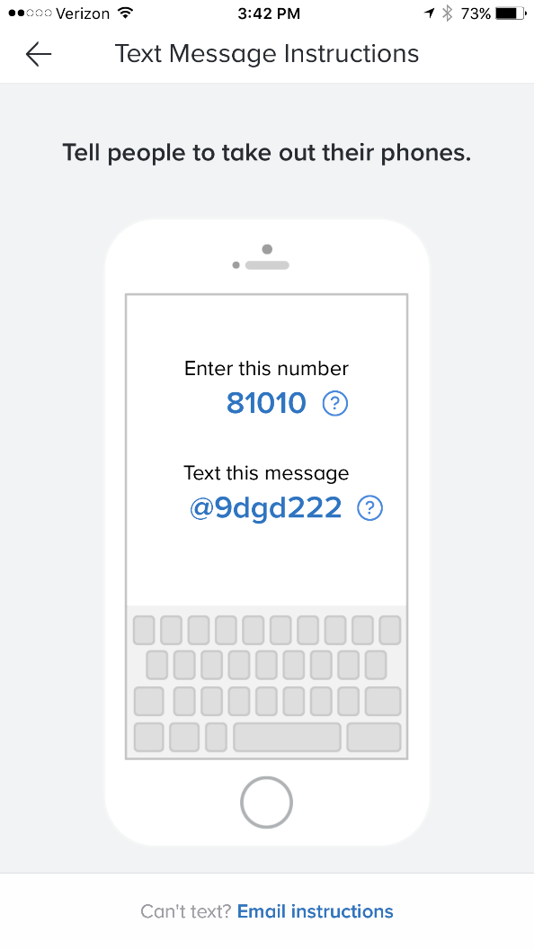
Sign up for Remind.com

Slide 6
FORMS AND PAYMENTS
FILL OUT FORMS AND LEAVE THEM HERE TONIGHT.
THERE ARE PARENTS HERE TO ACCEPT YOUR MEMBERSHIP DUES AFTER THE MEETING.
YOU MAY ALSO USE THE OSP OPTION.

Slide 7
Not just an Ordinary Chorus
We demonstrate……..Teamwork
We demonstrate…….. Commitment
We demonstrate…….. School Pride
We are “THE POWER OF ONE”!

Slide 8
Dedication and Teamwork
We are similar to Athletics and Cheerleading
It takes everyone to WIN, to be SUCCESSFUL
We sing year long from September through April
Busiest months are December, February, March, April
(aka “Tournament Time”)

Slide 9
Point System
All members of Patriot Pride will perform at one time or another throughout the year.
Some performances require everyone to sing, some have a limited number of singers. Some performances will be limited to 30 singers, we have 45 members.
Our point system is in place to establish accountability and reward.

Slide 10
How POINTS are earned
Every rehearsal is a point.
Every performance is a point.
If you attend during track out, you will receive a point.
Singing alone once a month
Bringing your music folder to rehearsal is a point.

Slide 11
How POINTS are lost
Late for a rehearsal or performance.
Absent from a rehearsal or performance.
Not bringing music to rehearsal
Not singing. Lip syncing.
Talking at inappropriate times.
Uniform infractions. Examples to include but not limited to:
no necklace, white socks, hair not put up, removing portions of uniform prior to leaving a performance venue, boys untucked shirts, leggings under dresses, missing black shoes, etc.

Slide 12
Rehearsals
Begin September 12
Time: 7:30-8:10 a.m. The door closes at 7:35. Students who are late, please report back to carpool since there is no supervision in the hallways.
All rehearsals are Tuesday and Thursday unless otherwise noted. Please check the Google calendar on heritagechorus.weebly.com

Slide 13
CONFLICT FORM- downloadable version on website heritagechorus.weebly.com
DATE CONFLICT FORM_____________
Student Name:_______________________________________________________
Parent name:_______________________________________________________
Grade:_________ Track:__________
List the dates that your student will MISS rehearsal. This includes dates you will miss during Track out. Rehearsals are mandatory unless you have prior approval from the Director.

Slide 14
MUSIC BEHAVIOR CONTRACT
Behavior Expectations:
-Students will respect the teacher and others
-Students will respect others personal space
-Students will follow directions at all times
-Students will be Cooperative, Honest, On Task, Mindful and Prepared for rehearsal (HMS Pride)
-Students will be active participants in rehearsal
-Students will be safe during rehearsals
Consequences if Behavior Expectations are broken:
Students will receive one warning with one chance to correct behavior. If students do not correct behaviors they will be written up to HMS Administration. We will operate on a three strikes and you’re out policy. If a student receives 3 major behavior write ups they will not be able to participate in the music group. If your child receives a behavior write up during rehearsal, parents will be notified and will be required to acknowledge the notification.

Slide 15
Who to contact?
Make the Google Calendar your friend!! Check the calendar first. Heritagechorus.weebly.com
Reach out to a Choir mom.
All members will receive a PPHC Directory later in September. Please ask your student to bring your copy home. Consider asking other parents to help with carpooling to rehearsals and performances.

Slide 16
Track Out
Out of town during track out? Students may be excused if the Parent contacts Mrs. Shuler within 12 hours of the absence.
If you are in town during track out, you are encouraged to join us for rehearsals.
Parent communication essential.
Only one excused absence per semester.
Notes:
We have other people who have auditioned. Your spot is in high demand. We learn new music every week. Don’t get behind.

Slide 17
Sign up to Volunteer
Sign up with Wake County to be a Volunteer by October 1st.
Be sure to check the box to be cleared for driving for Field Trips.
Sign up in the Media Center as soon as possible.

Slide 18
Committees
Please sign up tonight
Social Committee/Hospitality
Uniforms
Pictures and Video recording
Transportation
Year end Awards
Orlando Trip
Emergency Kit Coordinator

Slide 19
Fees due by Sept. 15th
This is a club, fees will be assumed by members:
Participation fee includes:
Spirit wear (hoody, t-shirt, backpack)
Formal dress and pearls for the girls
Tuxedo pants and shirt and vest and bow tie for the boys
Music
Awards
Activity Bus
Choreographers
Carolina Hurricane game ticket
New member’s participation fee: $250.00
Returning members participation fee: $150.00

Slide 20
Alterations
Parents assume the responsibility for girl’s dress alterations.
We recommend Andrea Baker from HHS. Her fee for hemming a dress is $10.00.
Dress should be hemmed to the floor.
Wear performance shoes when being fitted for alterations.
Especially 7th grade girls, leave plenty of room at the bottom of the dress for future alterations.
Savvi Formalwear will assume the responsibility for the boy’s alterations.

Slide 21
Formal Uniform Requirements-
Girls
Boys
Long, formal, burgundy gown with belt. Pressed.
Pearl necklace
Small pearl earrings of choice, not required
Flat, black dress shoes (no boots or high heels). Polished.
Flesh colored stockings. Knee-highs or full body
Natural hair color only
Black tuxedo pants
White tuxedo shirt
Button covers and cuff links
Black dress shoes, polished
Black dress socks, no footies
Natural hair color only

Slide 22
Garment Bag
All students be provided a garment bag with a zipper.
Garment bag should be labeled with student name and phone number.
Garments may be dropped off in the chorus room the morning of a performance.
All clothing items must be taken home at the end of each day.

Slide 23
Performances
School Pep Rally, TBA
Sing National Anthem for a Football Game, October 19, 4:00 p.m.
HMS Assemblies: Periods 3 and 4, December 1^{st,}
Community Christmas Celebration: December 1st
Pieces of Gold audition, Dec. 5 or 6
Governor’s Mansion and State Capitol Building, TBA
Department of Public Instruction, December
Cookies and Carols, Dec. 5th
Disney performance and workshop, March 1st and 2nd
Pieces of Gold, March 7th
Sing for a Carolina Hurricanes Game, February 16
Heritage Choral Festival, March

Slide 24
Student’s responsibility
Mrs. Shuler will email teachers one week prior to a performance or event that is held during the school day. These are approved field trips by the HMS Leadership Team. Students will be excused from class. Example: The Disney trip will be 3 days out of school.
However, when students miss school due to a performance, it is their responsibility to inform the teacher of their absence and to make up any work they may have missed.

Slide 25
WEBSITE HERITAGECHORUS.WEEBLY.COM
http://heritagechorus.weebly.com/patriot-pride-honors-chorus.html
http://heritagechorus.weebly.com/calendar.html

Slide 26
Disney World Trip
Letter from Disney:
Congratulations Heritage Middle School “Patriot Pride” Honors Chorus!
You have been selected by Disney Performing Arts to be part of the entertainment at the WALT DISNEY WORLD Resort! Attached is a PDF of your Event Itinerary showing the date that you will be performing.
Tuesday, September 19th at 5:00 p.m. Parent meeting for Band, Chorus and Dance participants going to Disney.
Trip dates are February 28-March 4, 2018

Slide 27
The importance of Music Education
Besides enjoyment, music helps with memory, language and reasoning.
Music fosters greater emotional development and creative thinking.
Music provides a sense of achievement and self-confidence.
The list goes on and on………….
Tito Munoz, conductor of Phoenix Symphony

Slide 28
Thank you for coming!
I look forward to leading “Patriot Pride”, Heritage Middle School’s premiere chorus!
Please complete Information Sheets and
leave them here tonight.
Sign up to be on a Volunteer Committee
Remit Club fees and information forms tonight.
Let’s have a great year!

